Slide 1
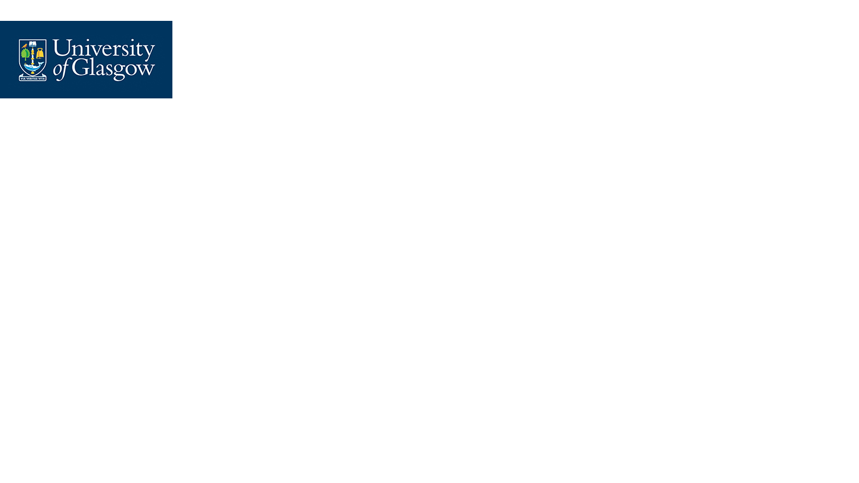


CSC 1103 Programming Methodology
Mini-Project 2024
INTERACTIVE TIC-TAC-TOE GAME WITH AI/ML FOR CHILDREN (GRP 8)
2403453 (3070572L) Gaddiel Lim Kang Seng
2401392 (3070649L) Sheila Lim Yann Tsern
2401883 (3070672T) Tan Bing Kun Terence
2401421 (3070651T) Tan Jian Xin
2401448 (3070653T) Tang Wei Shan Alicia

Slide 2

Task Distribution
Name | Scope
Gaddiel Lim Kang Seng | 4B (Naives Bayes model)
Sheila Lim Yann Tsern | 4B (Decision Tree model) Enhancements of Decision Tree Model
Tan Bing Kun Terence | 3 4A Hint System Exit Button
Tan Jian Xin | 1 2 Sound Effects Documentation, Pseudocode
Tang Wei Shan Alicia | 4C Grid Animations for Main page Tic-Tac-Toe GUI for Difficulty Selection & AI Selection Modes Back and Quit Buttons Winning Animation

Slide 3

Problem Definition
Primary Objective:
To develop a 3x3 Tic-Tac-Toe game in C
Incorporating ML/AI algorithms
For a memory and power-limited IoT tablet
Targets young children in a nursery childcare
Aims:
Foster motor skills, social skills, and the early development of analytical thinking skills
Features:
2 modes: a single-player and two-player mode
3 difficulty levels: Easy, Medium, Hard
AI designed with a level of imperfect playability (MiniMax, Naive Bayes & Decision Tree)
A user-friendly graphical user interface (GUI):
→ distinctive player symbols, turn-taking, winner declarations, and catchy sounds
A performance counter, tracking the wins for each difficulty mode
Sounds and Animations

Slide 4

Problem Analysis
User-Friendly GUI: Lightweight, visually engaging interface displaying symbols, turns, and winner announcements.
Two-Player Mode: Players alternate turns on a 3x3 grid
AI-Driven One-Player Mode:
Adjustable Difficulty
Minimax Algorithm
Naive Bayes
Decision Tree
Dataset
Hint Feature
Score Tracking
Memory Efficiency
Notes:
‹#›Script
Dataset: Trained with an 80:20 split of positive/negative moves, evaluated using accuracy metrics and confusion matrix.
Hint Feature: Suggests winning moves to guide users during gameplay.
Score Tracking: Monitors player progress to maintain a fun and educational experience.
Memory Efficiency: Optimized for smooth operation on resource-constrained IoT devices.

Slide 5


Individual Contributions Time
Notes:
‹#›

Slide 6




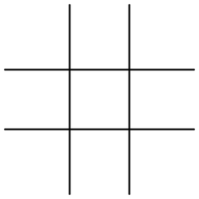
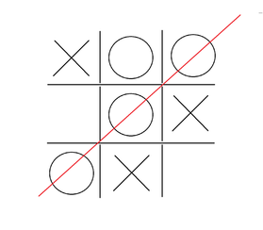
Tan Jian Xin (2401421)
Me
GUI
Game Structure
Game Logic
Notes:
‹#›Script
- Responsible for 3 main parts of the program, choosing and implementing the GUI, overall game structure and game logic
- Basically created a skeleton for the team to unleash their creativity

Slide 7

GUI
Lightweight and easy to use.
Many functions were readily available.
Documentation was comprehensive, installation was easy and utilisation was effortless.
Notes:
‹#›Script
- Experiment the implementation of the library, including the compile command, utilising the documentations, and identifying the libraries to be included.
- Raylib was chosen for its lightweight and easy to use nature
- Many functions such as InitWindow() for initialising the GUI window and LoadSound() for loading sound files, were readily available

Slide 8

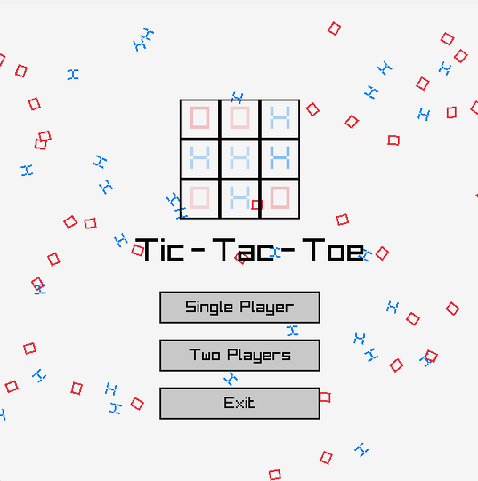
Game Structure - Main Menu
InitTitleWords()
InitSymbols()
UpdateTitleWords()
UpdateSymbols()
DrawMenu()
DrawButton()
DrawTitleWords()
DrawSymbols()
Sound Effects
Notes:
‹#›Script
Explain y r thr init, update and draw for some functions
- Init Functions: to initialise objects, such as where the objects should appear, only called once
- Update Functions(): Defines the behaviour of the object, like falling or jumping.
- Draw Functions(): Actually renders the object.
- InitTitleWords(): Initialises the Tic-Tac-Toe title.
- InitSymbols(): Initialises the falling Xs and Os
- UpdateTitleWords(): Update the position of each title words, including '-', to make them jump 1 by 1.
- UpdateSymbols(): update the position of the symbols to make them fall while rotating 360 degrees
DrawMenu(): renders the menu like the mini tictactoe, which is done by alicia, and the buttons, and set the hover status of the buttons to false = no hover effects
Other Draw functions: renders the objects based on the positions the Update functions provided
I have also added sound effects which can be found out more in the program itself.

Slide 9

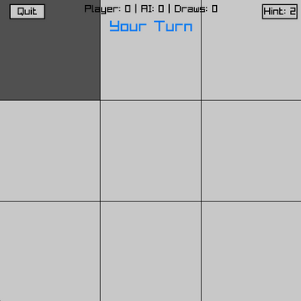
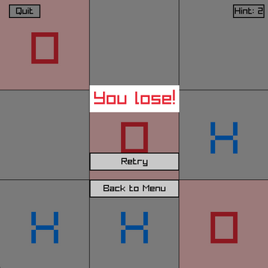
Game Structure - Game Interface
InitGame()
DrawGame()
UpdateGame()
UpdateGameOver()
HandleButtonHover()
RandomizeStartingPlayer()
Notes:
‹#›Script
- InitGame(): Initialises the game interface such as resetting the grids, stop the sound effects, reset winner and hints.
- DrawGame(): Renders the interface such as the grid lines, buttons and turn indicator.
- UpdateGame(): Update the state after user click single or 2 players, and call respective functions such as HandlePlayerTurn() or AITurn()
- UpdateGameOver(): Handles the logic and interactions for game over screen such as processing button clicks and changing game state.
- HandleButtonHover(): Check if the button is hovered.
- RandomizeStartingPlayer(): uses GetRandomValue (0 to 1) from raylib, if returned 0, X start, else O start.

Slide 10

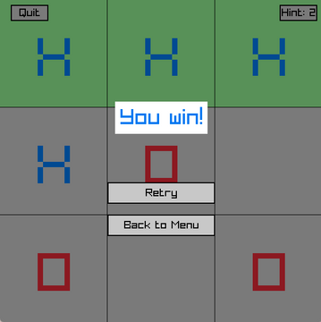
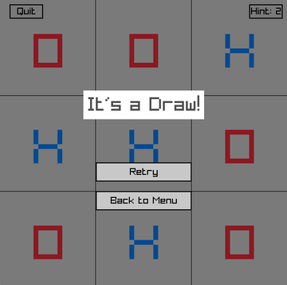
Game Logic
CheckWin()
CheckDraw()
HandlePlayerTurn()
Notes:
‹#›Script
- CheckWin(): Check if the grid is filled by the same player vertically, horizontally or diagonally
- CheckDraw(): check if there is an empty grid. If yes, return false. If all grids are filled and there is no winner, return true.
- HandlePlayerTurn(): Handles the player moves, button clicks, winning animation, sound effects and change the current player after player has made a move.

Slide 11



Tan Bing Kun Terence (2401883)
Me
Minimax
Hint System
Report
Imperfectness
Single Player
2.5 Hint System
Alpha-Beta Pruning
Two Player
8, 10.1, 10.2 Minimax
Notes:
Terence’s slides
‹#›Script
Thank you, Jian Xin, for your contributions. Hi Prof Lawrence, I’m Terence, and I’m here to share my contributions to this project. My work can be summarized into three main areas: Minimax, the Hint System, and Report Writing. Each of these areas highlights specific tasks and innovations I brought to the project.
Starting with Minimax:
In addition to implementing the full Minimax algorithm, I designed a depth-limited version of Minimax to introduce suboptimal moves.
I also optimized the Minimax algorithm by integrating Alpha-Beta Pruning.
Next, the Hint System:
I developed a dynamic hint system designed to assist players during gameplay. The system is tailored for both single-player and two-player modes, ensuring that hints remain helpful and fair in all game scenarios.
Lastly, Report Writing:
I contributed to documenting the system in detail, ensuring clarity and ease of understanding. My focus was on providing clear explanations for the implementation of Minimax, Alpha-Beta Pruning, and the Hint System

Slide 12
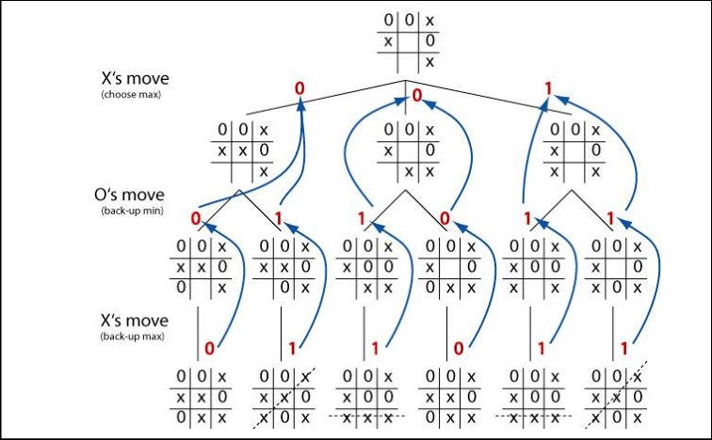

Tan Bing Kun Terence (2401883)
Minimax Algorithm
Maximizing Player (AI)
Minimizing Player (Player)
Runs on a depth first search algorithm
Exploration of all possible moves to the terminal state.
Evaluation of the game states and assign score based on result.
Backtracks result to minimizing or maximizing player
Select best move to AI
Function
Minimax()
Notes:
Terence's slide
‹#›Script
Minimax algorithm
Maximizing player which is the AI: Selects the move with the maximum score.
Minimizing player who is playing against Ai: Selects the move with the minimum score.
Explores all possible game states until terminal states (win, lose, or draw).
Assumes optimal moves by both players (maximizer and minimizer). if player did not play optimally, it will still be in the algorithms' favour
Returns the best possible outcome for the current player.
How It Works:
Generate Game Tree: Construct all potential moves and outcomes.
Evaluate Terminal Nodes: Assign scores (+10, -10, 0).
Backpropagate Values: Compute values for intermediate states by propagating scores upward based on the turn (maximizer or minimizer).
Guarantees the optimal solution.

Slide 13
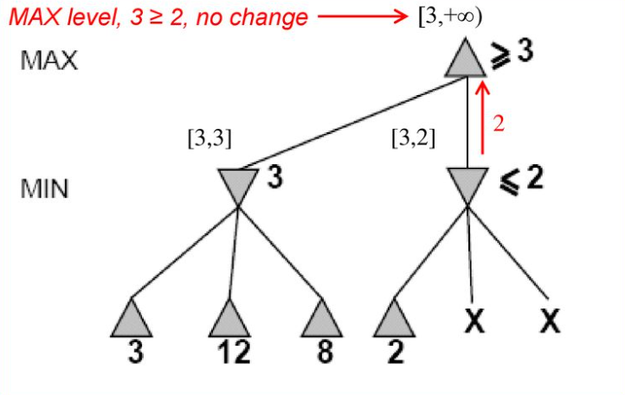

Tan Bing Kun Terence (2401883)
Limiting Depth Searching (Medium Difficulty)
Stops the algorithm from continuing the depth first search and backtrack.
Limited foresight due to depth restriction playing suboptimal moves.
Alpha-Beta Pruning
alpha for maximizing player
beta for minimizing player
If beta <= alpha, pruning will take place
Only explore relevant part of the tree
Notes:
Terence's slide
‹#›Script
Limit Depth Search
as mentioned previously minimax will explore all possibilities which is impossible for player to win, introduce stress and unhappiness
Alpha-Beta
By pruning unnecessary branches, Alpha-Beta significantly reduces computational costs while preserving accuracy,

Slide 14
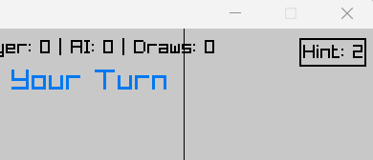

Tan Bing Kun Terence (2401883)
Hint System
To aid in player’s user experience and self learning
Utilize full minimax algorithm
Hint count will reduce after usage
Unusable once hint reaches zero
Functions
getHint()
clearHint()
Notes:
Terence's slide
I have decided to implement a hint system to help the player get the best move
each player will only have 2 chances

Slide 15


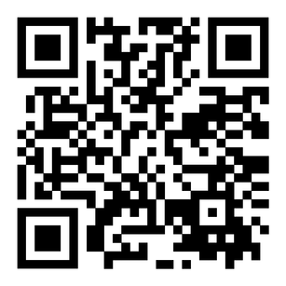
Tang Wei Shan Alicia (2401448)
Me
Features
Report
Others
1. Problem Definition
Difficulty Selection
Created main.h file
Performance Counter
2.6 Score Tracking
AI Model Selection
Pseudocodes for my functions
Winning Confetti Animation
2.7 Execution Instructions
Hover Animations
Created Demo video
Main Menu
Grid Animation
4. Function Descriptions
Back & Quit Buttons
10.3 Modular Approach

Slide 16

Tang Wei Shan Alicia (2401448)
UI and Animation Functions:
DrawDifficultySelect():
Draws an interface for players to select their preferred AI difficulty level.
DrawModelSelect():
Draws an interface for players to choose between different AI models when playing in Easy mode.
DrawRectangleRec():
Draws a color-filled rectangle.
DrawButton():
Added button vibration feature.
DrawConfetti():
Draws the confetti particles on the screen.
InitConfetti():
Initializes the confetti particles for the animated UI upon winning.
UpdateConfetti():
Updates the position and rotation of confetti particles.

Slide 17

Tang Wei Shan Alicia (2401448)
Standard Functions:
sprintf(char *str, const char *format, ...):
Sends formatted output to a string.
sinf(float x):
Computes the sine (specified in radians) of x.
Game Logic:
GetCurrentModeStats():
Tracks game statistics (wins, losses and draws) for each difficulty mode and AI model.
Raylib Functions:
SetSoundVolume():
Sets volume for a sound (Max level: 1.0).
StopSound():
Stops playing a sound.
SetMouseCursor():
Sets mouse cursor.

Slide 18
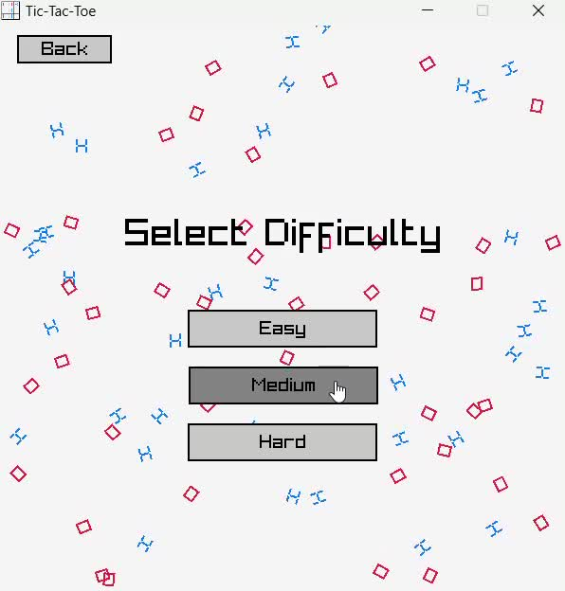

Tang Wei Shan Alicia (2401448)
Difficulty Selection Screen
AI Model Selection Screen
Back Button Feature
Hover Animation

Slide 19
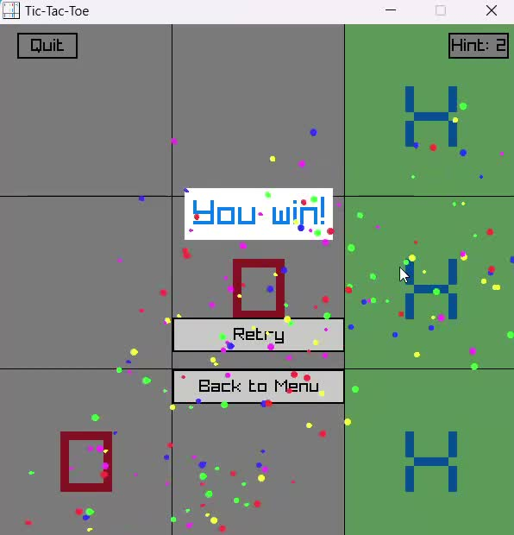
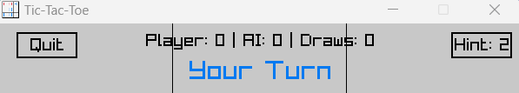

Tang Wei Shan Alicia (2401448)
Winning Animation
Performance Counter

Slide 20

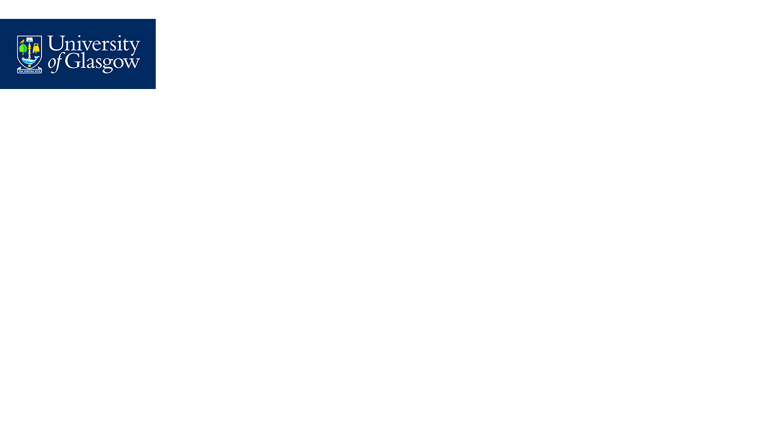

Gaddiel Lim Kang Seng (2403453)
Trained Naive Bayes Model with around 70% accuracy
Implementation of model into Tic-Tac-Toe game
Notes:
Gaddiel’s slides

Slide 21

Implementation of Naive Bayes Model (Easy mode):
Extracting and Processing of dataset
Using the provided tic-tac-toe.data dataset (960 lines) to train the model.
First 630 lines were for positive outcome, next 330 were for negative outcome.
So if we were to immediately split the first 80% lines for training and next 20% for testing. Training would be very skewed towards just predicting positive outcomes, and the models would not be able to predict any negative outcomes accurately.
Randomly shuffled the dataset before splitting to ensure generalization and avoid biasness during training.

Slide 22

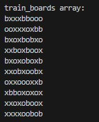
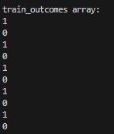
Implementation of Naive Bayes Model (Easy mode):
Extracting and Processing of dataset
load_data() function
Load the dataset into 2 different arrays, one containing the features (Tic-Tac-Toe board layout), and the other containing the respective outcomes (“positive” or “negative”).
outcome_index() function
Convert the string outcomes into the corresponding numerical label ( POSITIVE = 0 or NEGATIVE = 1 ). Increased memory efficiency and faster training speed, as numerical labels consume less memory and computation involving numbers is faster compared to string labels.
split_data() function
Randomly shuffle the dataset using Fisher-Yates algorithm. Iterates through the array backward, swapping the current element with a randomly chosen index from 0 to the current index, ensuring unbiased randomization.
Then take the first 80% of shuffled dataset for training data and next 20% for testing data.
First 10 lines of training datasets:
train_boards array (features): train_outcomes array (outcomes):

Slide 23

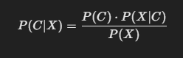
Implementation of Naive Bayes Model (Easy mode):
Training of model
Logic of Naive Bayes:
It assumes the features are independent of one another given the outcome
Uses Bayes’ Theorem to calculate the Posterior Probability which is needed to predict the outcome/classes (positive/negative) given the features
P(C|X) Posterior Probability formula: Probability of the outcome C given the board configuration X
P(C) Prior Probability: Probability of outcome C (positive/negative) appearing in the dataset
P(X|C) Conditional Probability(Likelihood): Probability of a feature X occurring in a given outcome C
For eg, how often the feature ‘o’ in position 2 occurs in all the ‘positive’ outcome
P(X) Marginal Probability(Evidence): Probability of feature X occurring in the dataset regardless of outcome C
For eg, how often the feature ’x’ in position 7 occurs in the dataset regardless of outcome
However, I did not include the dividing of the evidence as it remains constant for all outcome C given the feature X. Instead, we compare the unnormalized Posterior Probability for each outcome and pick the one with the highest value.

Slide 24
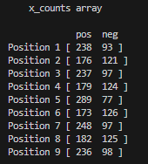
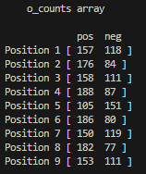
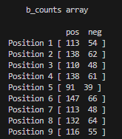

Implementation of Naive Bayes Model (Easy mode):
Training of model
train_NBmodel() function: Train a model with the Naive Bayes Algorithm by computing the probabilites
Counts the number of occurrences of each feature and each outcome in the dataset
Calculates the Prior Probability of each class [number of occurrences of each outcome / size of dataset]
Calculates the Conditional Probability for each feature in each outcome [number of occurrences of each feature in each position / number of occurrences of the respective outcome]
save_NBmodel() function: Save the weights of the model (calculated prior and conditional probabilities) into a text file (“NBmodel_weights.txt”)
Visualization of the arrays containing the number of occurrence for each features in each position in each class

Slide 25

Implementation of Naive Bayes Model (Easy mode):
Saving weights of model
Contents of “NBmodel_weights.txt”:
Class Probabilities:
P(Positive): 0.648825
P(Negative): 0.351175
Position 1:
P(x | Positive): 0.476000
P(x | Negative): 0.378676
P(o | Positive): 0.288000
P(o | Negative): 0.437500
P(b | Positive): 0.236000
P(b | Negative): 0.183824
Position 2:
P(x | Positive): 0.356000
P(x | Negative): 0.459559
P(o | Positive): 0.360000
P(o | Negative): 0.294118
P(b | Positive): 0.284000
P(b | Negative): 0.246324
Position 3:
P(x | Positive): 0.482000
P(x | Negative): 0.360294
P(o | Positive): 0.308000
P(o | Negative): 0.455882
P(b | Positive): 0.210000
P(b | Negative): 0.183824
Position 4:
P(x | Positive): 0.362000
P(x | Negative): 0.466912
P(o | Positive): 0.364000
P(o | Negative): 0.312500
P(b | Positive): 0.274000
P(b | Negative): 0.220588
Position 5:
P(x | Positive): 0.592000
P(x | Negative): 0.286765
P(o | Positive): 0.230000
P(o | Negative): 0.566176
P(b | Positive): 0.178000
P(b | Negative): 0.147059
Position 6:
P(x | Positive): 0.346000
P(x | Negative): 0.466912
P(o | Positive): 0.374000
P(o | Negative): 0.308824
P(b | Positive): 0.280000
P(b | Negative): 0.224265
Position 7:
P(x | Positive): 0.472000
P(x | Negative): 0.371324
P(o | Positive): 0.296000
P(o | Negative): 0.444853
P(b | Positive): 0.232000
P(b | Negative): 0.183824
Position 8:
P(x | Positive): 0.364000
P(x | Negative): 0.455882
P(o | Positive): 0.364000
P(o | Negative): 0.297794
P(b | Positive): 0.272000
P(b | Negative): 0.246324
Position 9:
P(x | Positive): 0.452000
P(x | Negative): 0.356618
P(o | Positive): 0.324000
P(o | Negative): 0.433824
P(b | Positive): 0.224000
P(b | Negative): 0.209559

Slide 26

Implementation of Naive Bayes Model (Easy mode):
Calculation of Posterior Probability +
and Outcome
calculate_probability() function:
To calculate the Posterior Probability of a specified outcome based on a given board layout.
Uses the computed prior and conditional probability to perform the Bayes’ Theorem formula without the use of division with the marginal probability
For example, if user set outcome argument as "positive" and the given board layout is “bxobxobxo”, the function would calculate how probable the given board layout would lead to a "positive" outcome.
Formula:
P("positive:|X) = P("positive:) * P('b'1|"positive") * P('x'2|"positive") * ... * P('o'9|"positive")
predict_outcome() function: To predict whether the given board layout would lead to either a “positive” or “negative” outcome, by comparing the Posterior Probability of both outcome using the calculate_probability() function and returning the higher one.

Slide 27

Implementation of Naive Bayes Model (Easy mode):
Application into the game
predict_move() function : Play the game against players
Takes in the current state of the game, the current board layout
Simulates a move separately in every available(blank) spot and calculates the probability of winning with that respective move. Passing the “positive” argument into the calculate_probability() function.
Loops through every calculated probability of winning
Returns (play) the move that results in the highest probability.

Slide 28

Implementation of Naive Bayes Model (Easy mode):
Application into the game
The predict_move() function simulates the game board as a string. For eg “obxxoxbbo”.
Leftmost character => position 1, rightmost => position 9.
After predicting the best move, it will arrive at an integer (0-8) representing one of the positions on the board.
However, the GUI reads and writes the board as an array. Such as, [‘o’ , ‘b’ , ‘x’]
[‘x’ , ‘o’ , ‘x’]
[‘b’ , ‘b’ , ‘o’]
To access position 7 on the board, need to return two values (2,0), representing the indexes of the row and column of the array respectively.
Hence, created a loop to read in the board from the GUI and convert it into a string, so then the function can simulate the moves and get the best move.
Then call the divide() function to convert the best move integer into the row and column indexes of the board.
Return the indexes to the backend to play the move
Therefore, successfully implementing the trained Naive Bayes model into the game

Slide 29

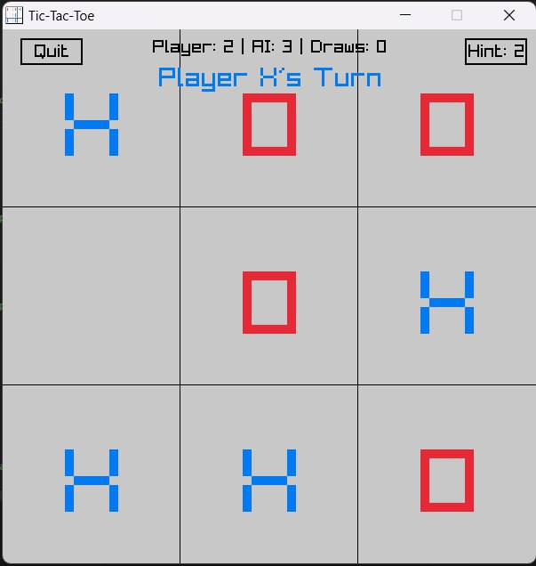
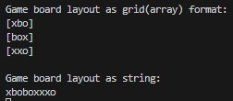
Implementation of Naive Bayes Model (Easy mode):
Application into the game
Board conversion
Current board layout (GUI) Conversion of grid to string
Note: Even though in position 2 there is a ‘b’ in the grid format but the GUI shows a move has been made there, it is because the loop only occurs when it is the AI’s turn to play but the move has not been made yet. The GUI shows the board after it made its move which is position 2

Slide 30

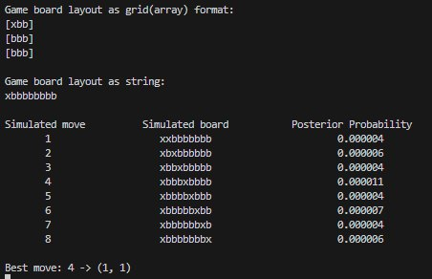
Implementation of Naive Bayes Model (Easy mode):
Application into the game
predict_move() function:
Notes:
this is the

Slide 31
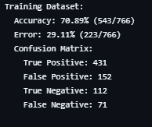
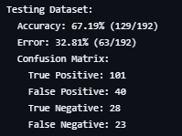
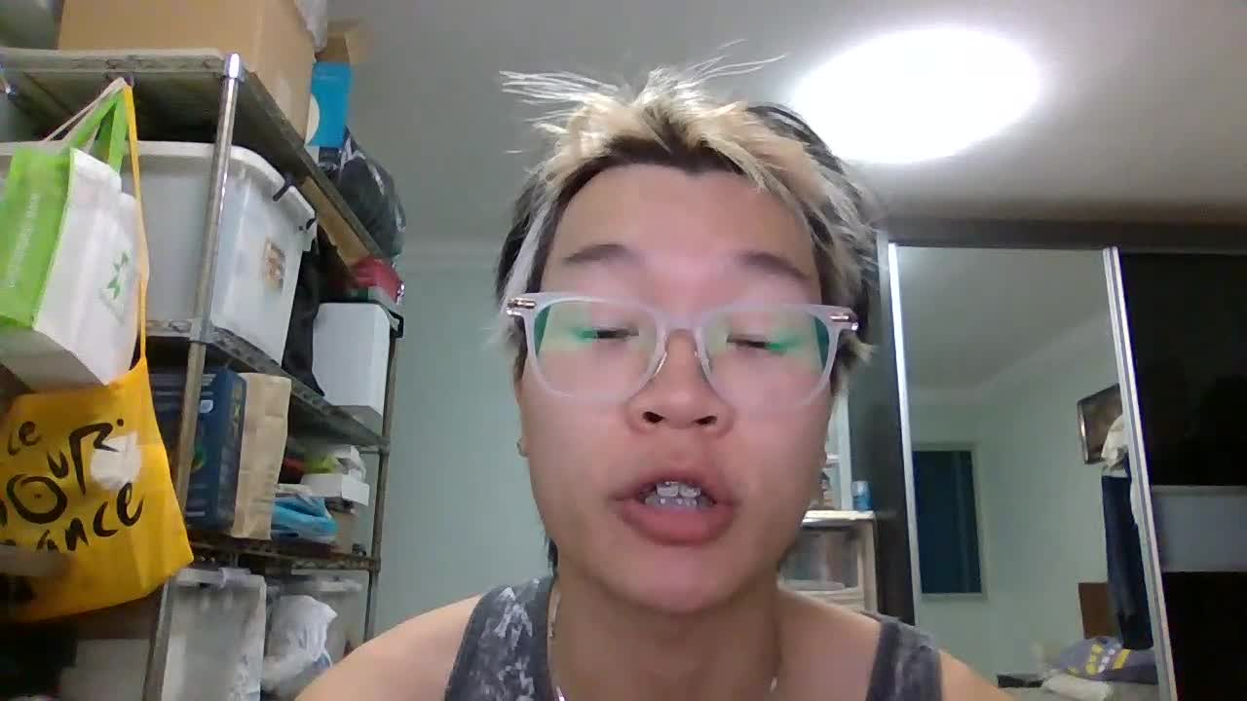
Implementation of Naive Bayes Model (Easy mode):
Evaluation of model
test_NBmodel() function: To test the accuracy of the model on both training and testing dataset
First count the number of wrong outcomes[error_count], True Positive (TP), False Positive (FP), True Negative (TN), False Negative (FN) predictions the model makes
Use values to compute Accuracy and Probability of Error of the trained model
Then save the results in a text file (“NBmodel_confusion_matrix.txt”) for plotting of confusion matrix

Slide 32
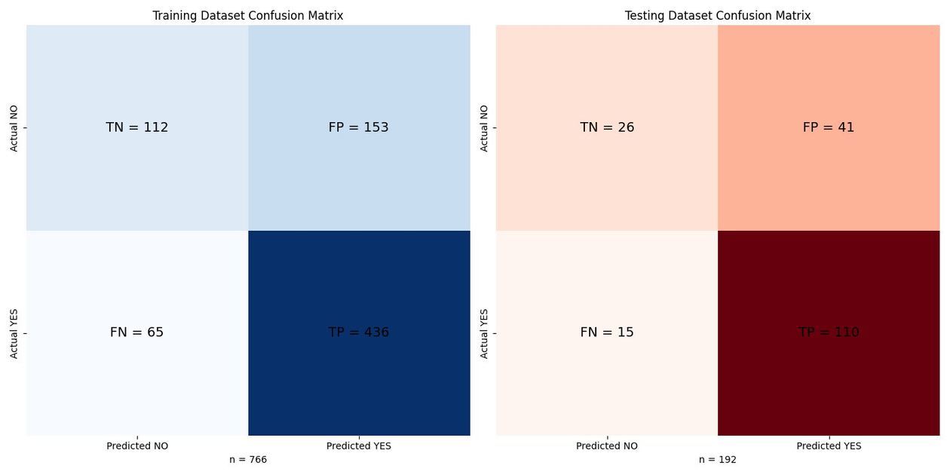

Implementation of Naive Bayes Model (Easy mode):
Review of model
plot_confusion_matrix.py file
Run this python file to get the confusion matrix of the testing of the model on both training and testing dataset
Gets the data from text file (“NBmodel_confusion_matrix.txt”) and plot it using python libraries (matplotlib, seaborn, numpy)

Slide 33
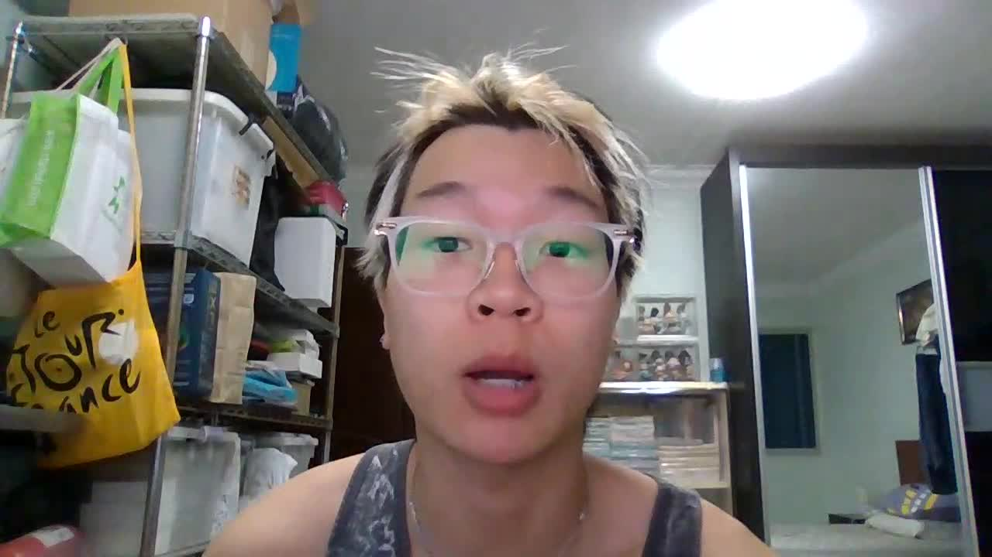
Implementation of Naive Bayes Model (Easy mode):
Review of model
Matrix Analysis:
436 + 112 = 548 correct predictions out of 766 outcomes in the training dataset.
548/766 X 100 = 70%
110 + 26 = 136 correct predictions out of 192 outcomes in the testing dataset.
136/192 X 100 = 70%
70% accuracy in predicting the correct outcome.
70% chance of choosing the correct next best move while playing against players.
Sufficient for an easy mode.

Slide 34
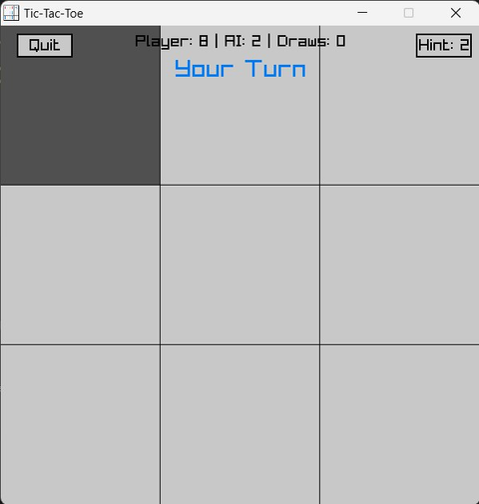
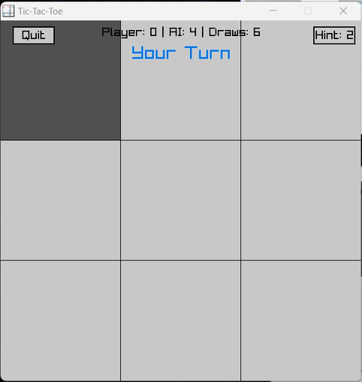

Implementation of Naive Bayes Model (Easy mode):
Naive Bayes VS MiniMax
Naive Bayes model is weaker than the Minimax Algorithm.
Naive Bayes algorithm only trains the model to get the probability of winning in all 9 squares and ranks them in descending order.
For example, based on the NB model weights, the center square always leads to the highest probability of winning, hence it would always try to make a move there.
Thus, the NBmodel does not detect the winning move for both the player and itself.
Resulting in it not being able to always stop the player from winning or making its winning move when presented with the chance.
Against Naive Bayes
Against Minimax

Slide 35



Sheila Lim Yann Tsern (2401392)
Me
Features
Features Enhancements
Report Writing
Training of Decision Tree
Randomness to Decision Tree
Decision Tree
Testing of Decision Tree
Memory Free Allocation
Enchancements
Evaluation of Decision Tree
Comparison of AI Models
Integrated with Confusion Matrix Plot for Visualisation
Pseudocode
Implementation of Model to Easy Mode
Notes:
Terence’s slides
‹#›

Slide 36


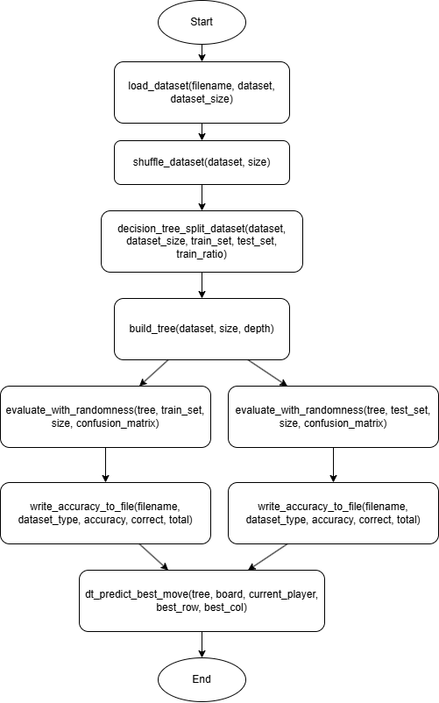
Implementation of Decision Tree (Easy Mode)
Flowchart of Main Program Flow
Overview of Decision Tree
Main Functions Calling Order:
Start
|
|----> load_dataset()
|
|----> shuffle_dataset()
|
|----> decision_tree_split_dataset()
|
|----> build_tree()
|
|----> evaluate_with_randomness()
|
End
Notes:
‹#›

Slide 37

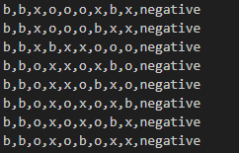
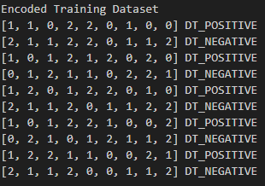
Predicting the best moves in Tic-Tac-Toe using Decision Tree Model
Orginal Dataset
Data Preprocessing - Assign Labels
i. Board Outcomes
“positive” = DT_POSITIVE (WIN)
“negative” = DT_NEGATIVE (LOSE/DRAW)
ii. Preprocess symbol as numerical values
1 for an x
2 for an o
0 for a blank
Encoded Dataset
iii. Data processed into an array of DataRow structures
iv. The conversion ensures
Memory efficiency
Faster training speed in numerical operations than string operations
Better performance during model training & evaluation
Notes:
‹#›

Slide 38

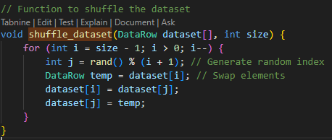
Implementation of Decision Tree (Easy Mode)
Data Splitting
Split data into 80:20 for the ratio of the training set and test set
Shuffle Dataset
The dataset has 630 positive outcomes > 330 negative outcome
Performed a Fisher-Yates shuffle in order to randomize the dataset in an unbiased manner
One of the efficient ways to generate a random permutation of the dataset is by using the Fisher and Yates algorithm so as to make sure that this model is not biased based on the ordering of data
This random shuffling stops over-fitting-the data becomes well distributed preventing the model from memorizing sequences
Notes:
‹#›

Slide 39

Implementation of Decision Tree (Easy Mode)
Feature (feature_index)
Each feature represents the state of a board position (one of the 9 cells in the 3x3 grid).
For example:
feature_index = 1: The top-left cell
feature_index = 5: The center cell
feature_index = 9: The bottom-right cell
Threshold (threshold)
Defines the rule/evaluation for splitting the dataset based on the selected feature.
threshold = 0: Empty cell
threshold = 1: Cell occupied by 'X'
threshold = 2: Cell occupied by 'O'
Decision Tree Construction and Training
Dataset is divided into two subsets (left & right) using the decision_tree_split_data function based on the selected feature & threshold
Left Subset: Samples where feature ≤ threshold
For example, board states where the center cell is empty or has 'X'
Right Subset: Samples where feature > threshold
For example, board states where the center cell has 'O'
Calculate Gini Impurity for the splitting of both left and right branches
Notes:
‹#›

Slide 40

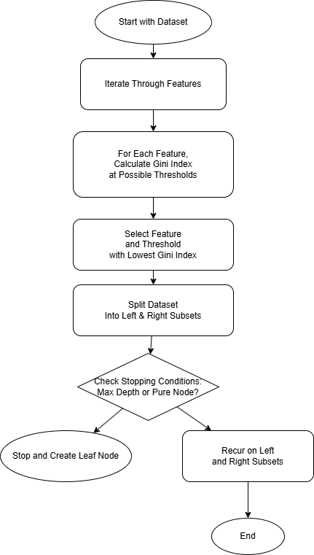
Implementation of Decision Tree (Easy Mode)
Flowchart of the build_tree function
Building the Decision Tree
Built using build_tree() function
Used recursive process to identify the best splits based on features and thresholds measured with LOWEST Gini Index
Stop when pure node, max depth or perfect classification is reached
Else, it will keep recurring on both branches
Gini Index (Gini impurity) Overview
A measure of impurity of a dataset and is commonly used in decision trees to help find the optimal splits of the data to ensures effectiveness of the split
Helps identify features that result in more homogeneous subsets of data
Create more accurate & reliable predictive models
Value ranges between 0 (pure split) and 1 (max impurity)
Notes:
‹#›

Slide 41

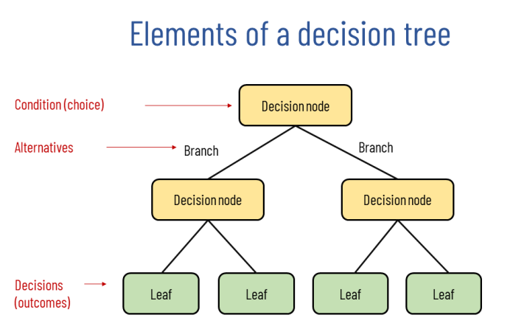
Implementation of Decision Tree (Easy Mode)
Decision Tree Construction and Training
The process iterates over all the 9 features (NUM_FEATURES = 9) representing the cells on a Tic-Tac-Toe board
If the current split's Gini Index is lower than the previously recorded best, it updates:
best_feature → Feature responsible for the split
best_threshold → Value used to split the feature
best_gini → Gini Index of the split
Notes:
‹#›

Slide 42

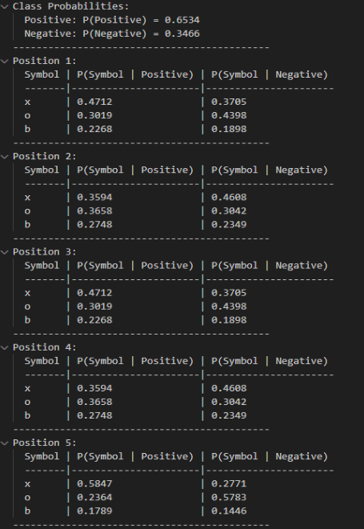
Implementation of Decision Tree (Easy Mode)
Calculating Position Probabilities
Used calculate_position_probabilities() function to
Computes weights for each board position using the Tic-Tac-Toe dataset.
Calculates probability of symbols ('x', 'o', empty) at each position given the class label (positive or negative).
Counters Initialization
positive_count & negative_count initialized to 0 to track outcomes
3D Array (position_count[NUM_FEATURES][3][2]):
NUM_FEATURES = 9: Board positions
3 Values: Symbol values ('x', 'o', empty)
2 Classes: Game outcome (positive or negative)
Iterate through dataset entries to update both of class counters
Saves results to DTweights.txt for future analysis & model prediction & evaluation
Notes:
‹#›

Slide 43

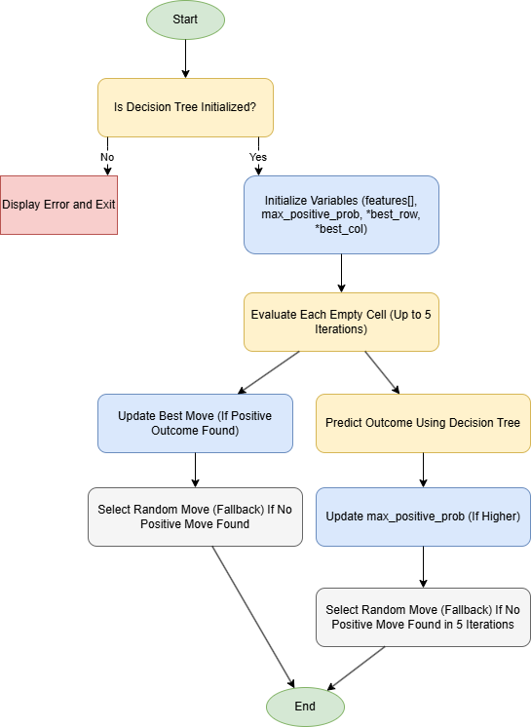
Implementation of Decision Tree (Easy Mode)
Decision Tree Model Prediction - dt_predict_best_move
Flowchart - dt_predict_best_move
Function Purpose
Predicts the best move for AI in Tic-Tac-Toe for each empty cell
Uses the trained decision tree (Weights) to analyze board state
Inputs
*DecisionTreeNode tree: Root of the decision tree.
char board[3][3]: Current board state ('x', 'o', 'b').
char current_player: Current player ('x' or 'o').
**int best_row, int best_col: Stores coordinates of the best move
Error Handling
Verify tree is initialized.
If tree is NULL, display error and exit
Iteration for Optimal Move
Evaluate each empty cell ('b') up to 5 iterations.
Predict outcome for current player’s move in the cell.
Update best move if prediction shows higher positive outcome
Fallback Strategy
If no positive move found in 5 iterations, select a random empty cell
Guarantees a move is always recommended even when no clear options/advantages
Notes:
‹#›

Slide 44

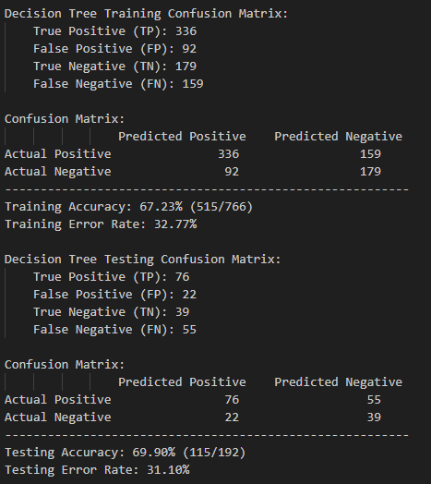
Implementation of Decision Tree (Easy Mode)
Evaluation of Decision Tree Model & Confusion Matrix
Evaluation Approach
Model evaluated using training & testing datasets
train_confusion[2][2] & test_confusion[2][2] (2x2 matrices) track outcomes
Initial values set to zero, updated based on prediction outcomes during iteration over dataset entries.
Key metrics: accuracy, error rate & confusion matrices
Evaluation focused on model's ability to simulate intelligent decision-making in Tic-Tac-Toe gameplay
Confusion Matrix Overview
Confusion Matrix Elements
True Positive (TP): Correctly predicted positive instances
True Negative (TN): Correctly predicted negative instances
False Positive (FP): Incorrectly predicted positive instances
False Negative (FN): Incorrectly predicted negative instances
Confusion Matrix for Training Set
Confusion Matrix for Testing Set
Notes:
‹#›

Slide 45

Implementation of Decision Tree (Easy Mode)
Accuracy, Error Rate, and Metrics
Accuracy, Error Rate, Dataset Splitting for Training Set
Performance Metrics Calculation
Accuracy: Ratio of correct predictions to total predictions
train_accuracy = (float)correct_predictions / train_size
test_accuracy = (float)correct_predictions / test_size
Error Rate: Percentage of incorrect predictions made by the model
Calculated using calculate_error_rate() function
Training and Testing Split:
Training Phase: Model trained using 80% of dataset as shown in the image above.
Training accuracy and training error rate offer insights into model performance during learning.
Testing Phase: Evaluated using remaining 20% of dataset as shown in the image above.
Accuracy, Error Rate, Dataset Splitting for Testing Set
Notes:
‹#›

Slide 46

Implementation of Decision Tree (Easy Mode)
Snippet of DTconfusion_matrix.txt
Confusion Matrix and Other Metrics Results Saved
Results saved in "DecisionTree_ML/DTconfusion_matrix.txt" each time and used for plotting Confusion Matrix Plot
Includes confusion matrix, accuracy, error rate and dataset splitting details for both training and testing phases
Notes:
‹#›

Slide 47

Implementation of Decision Tree (Easy Mode)
Model Results Review
Training and Testing Accuracy
Training Accuracy: 67.23% ; Testing Accuracy: 69.90%
Model Performance Analysis
Close values for training and testing accuracy indicate balanced performance, no overfitting
Confusion matrix provided insights as such:
False Positives (FP) < False Negatives (FN) suggesting the model is more conservative in predicting positives
In my opinion, the trained decision tree model is optimal for our gameplay in easy mode for player to play against to have better chances of winning the game
Ensuring Robustness
Combination of predictive modeling and error analysis helped refine the decision tree
Model learned from errors improving its future performance
Notes:
‹#›

Slide 48
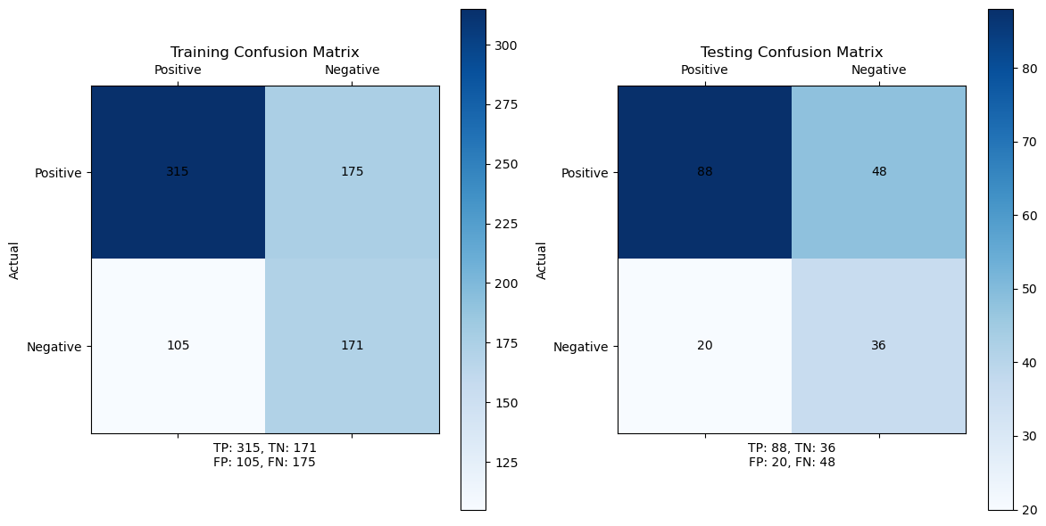

Implementation of Decision Tree (Easy Mode)
Integrated with Confusion Matrix Plot and Results
Run confusionmatrix.py file
This script generates a confusion matrix plot using the data from the DTconfusion_matrix.txt file
The resulting matrix will be displayed as a plot and saved as a PNG image named DT_Confusion_Matrix.png
Notes:
‹#›

Slide 49

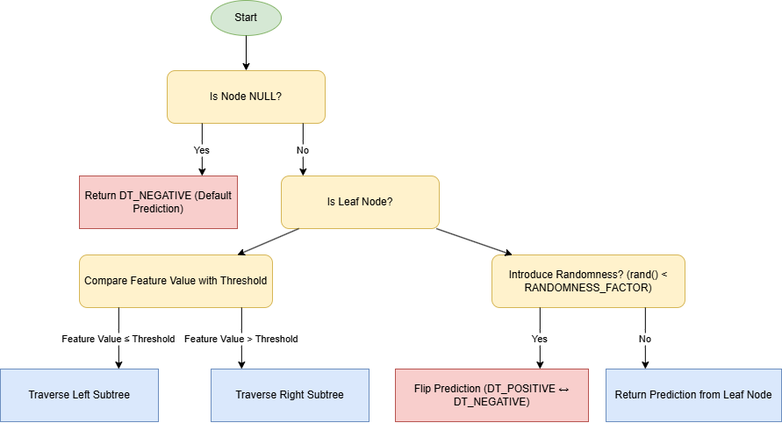
Implementation of Decision Tree
(Easy Mode)
Features Enhancements: Predictive Randomness
How RANDOMNESS_FACTOR Works
Value Range
RANDOMNESS_FACTOR is a float between 0.0 and 1.0, representing a probability.
Condition
A random value (from rand() normalized by RAND_MAX) is compared against RANDOMNESS_FACTOR.
If random value < RANDOMNESS_FACTOR: The prediction is flipped (e.g., from positive to negative or vice versa).
Else: The normal prediction is returned
Flowchart for Predictive Randomness
Normally, our model would pick the ‘best’ move
For example, if with a 20% randomness factor
Occasionally choose a less obvious or even suboptimal move to surprise the player
Makes the predictions less rigid and more human-like & make gameplay more interesting & dynamic
Notes:
‹#›

Slide 50

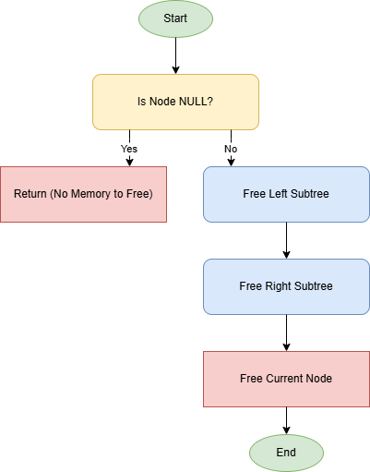
Implementation of Decision Tree (Easy Mode)
Features Enhancements: Memory Free Allocation
Function free_tree() purpose
Go through the entire decision tree and free up memory systematically ensuring that no parts of the tree are left using up valuable resources
How Memory Deallocation Works
Check for NULL Node
if a given node is NULL, meaning there is no memory to free. If it is, the function simply returns
Recursive Deallocation
It then recursively calls itself to free the memory for the left and right parts of the tree
This ensures that every branch of the tree is deallocated
Once the left and right subtrees are dealt with, the function frees the current node itself ensuring no part of the tree is left in memory.
Flowchart for free_tree
Notes:
‹#›

Slide 51

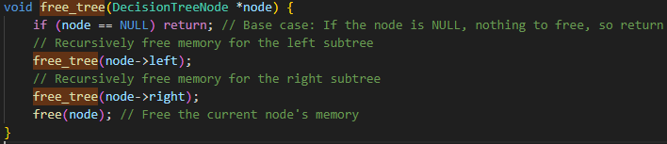
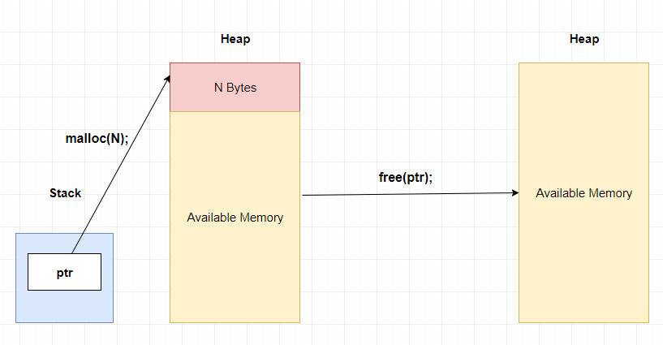
Implementation of Decision Tree
(Easy Mode)
Features Enhancements: Memory Free Allocation
Why This Is Important？
Prevents Memory Buildup
When we train our decision tree multiple times—maybe with different datasets or during parameter tuning—memory can build up if not properly cleared
This function ensures that all old memory is efficiently cleared before new memory is used
Ensures Robustness
By cleaning up after each training session, the model becomes more robust and ready for new training cycles without slowing down or running into memory issues
Notes:
‹#›

Slide 52

Implementation of Decision Tree (Easy Mode)
AI Model Comparison: Minimax vs. Decision Tree
Minimax Algorithm
Ensures perfect, optimal moves /strategies that is predictable and computationally intensive
Less chance to win the AI’s player
Ideal for games where optimality is crucial & suitable for Medium and Hard mode in our gameplay
Decision Tree
Introduces randomness to create dynamic, less predictable gameplay
Higher chance to let the player win the game provides user-friendly gameplay
Its lower computational requirements make it well-suited for real-time play
Trade-off
Use Minimax for optimal moves gameplay
Use Decision Tree for more engaging gameplay experiences
Notes:
‹#›

Slide 53






Closing slide – You can add contact details, a call to action or a simple thank you
#UofGWorldChangers
@UofGlasgow
Notes:
‹#›

